Slide 1
Deterministic Policy Gradient Algorithms
Uk Jo

Slide 2
DDPG
David Silver
ICML, Beijing, China, 2014 accepted paper. Not important for him
Very fundamental paper including SOTA RL alogrithms nowadays such as BicNet, MADDPG, TD3, Proposed
http://proceedings.mlr.press/v32/silver14.pdf

Slide 3
Deterministic Policy?
deterministic policy gradient can be estimated much more efficiently than the usual stochastic policy gradient.
To ensure adequate exploration, we introduce an off-policy actor-critic algorithm that learns a deterministic target policy from an exploratory behaviour policy.
We demonstrate that deterministic policy gradient algorithms can significantly outperform their stochastic counterparts in high-dimensional action spaces.

Slide 4
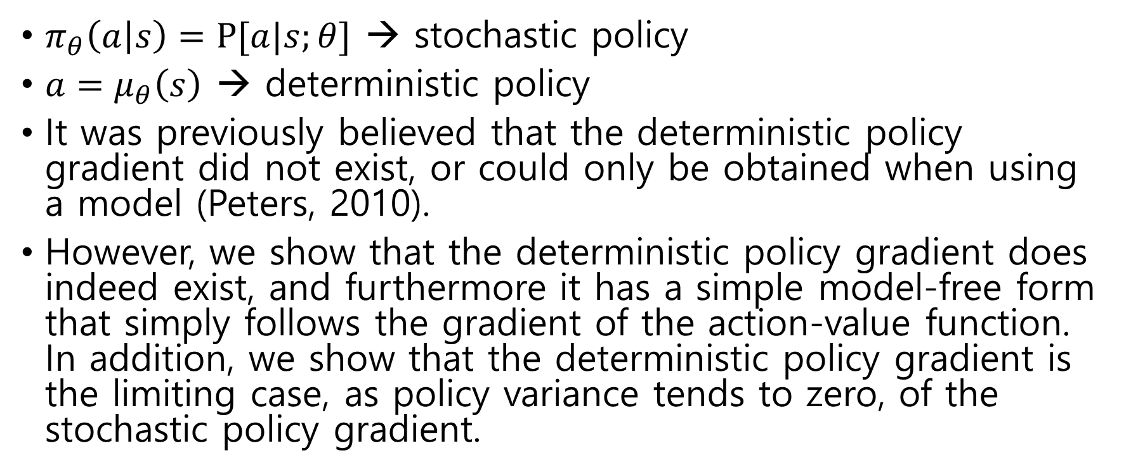
Deterministic Policy?
$π_{θ}\left(a | s\right)=Ρ[a|s;θ]$ → stochastic policy
$a=μ_{θ}\left(s\right)$ → deterministic policy
It was previously believed that the deterministic policy gradient did not exist, or could only be obtained when using a model (Peters, 2010).
However, we show that the deterministic policy gradient does indeed exist, and furthermore it has a simple model-free form that simply follows the gradient of the action-value function. In addition, we show that the deterministic policy gradient is the limiting case, as policy variance tends to zero, of the stochastic policy gradient.

Slide 5
Difference with stochastic policy
Stochastic policy gradient integrates over both state and action spaces, whereas in the deterministic case it only integrates over the state space.
As a result, computing the stochastic policy gradient may require more samples, especially if the action space has many dimensions.
In order to explore the full state and action space, a stochas- tic policy is often necessary.

Slide 6
Idea
To ensure that deterministic policy gradient algorithms continue to explore satisfactorily, we introduce an off-policy learning algorithm.
The basic idea is to choose actions according to a stochastic behaviour policy (to ensure adequate exploration), but to learn about a deterministic target policy (exploiting the efficiency of the deterministic policy gradient).
We use the deterministic policy gradient to derive an off-policy actor-critic algorithm that estimates the action-value function using a differentiable function approximator, and then updates the policy parameters in the direction of the approximate action-value gradient.
We also introduce a notion of compatible function approximation for deterministic policy gradients, to ensure that the approximation does not bias the policy gradient

Slide 7
Why DPG over SPG?
Our results demonstrate a significant performance advantage to using deterministic policy gradients over stochastic policy gradients, particularly in high dimensional tasks.
require no more computation than prior methods: the computational cost of each update is linear in the action dimensionality and the number of policy parameters.
Finally, there are many applications (for example in robotics) where a differentiable control policy is provided, but where there is no functionality to inject noise into the controller. In these cases, the stochastic policy gradient is inapplicable, whereas our methods may still be useful.

Slide 8

Preliminaries
$S$: states x-y, HP, command, enemy x-y, enemy hp…
$A$: actions up/down/right/left …
$P_{sa}$: transition probabilities $s_{t+1}=f\left(s_{t}, a_{t}\right)$
$Γ$: discount factor
$R$: reward function win/lose …
$π\left(a | s\right)=P[A_{t}=a|S_{t}=s]$
$G_{t}=R_{t+1}+γR_{t+2}+γ^{2}R_{t+3}…=\sum_{k=0}^{∞}{γ^{k}R_{t+k+1}}$
$V^{π}\left(s\right)=E\left[r_{1}^{γ} | S_{1}=s;π\right] Q^{π}\left(s,a\right)=E\left[r_{1}^{γ} | S_{1}=s, A_{1}=a;π\right]$
$J\left(π\right)=E\left[r_{1}^{γ}\right| π]$
$ρ^{π}\left(s′\right)≔ \int_{s}{ρ^{π}\left(s\right)\int_{A}{π_{θ}\left(s,a\right)r\left(s,a\right)dads=𝔼_{s \sim ρ^{π},a \sim π_{θ}}\left[r\left(s,a\right)\right] where }p\left(s→s^{′}, t, π\right) means the density at state s^{′} after transitioning for t time steps from state s}$
$J\left(π_{θ}\right)= \int_{S}{\sum_{t=1}^{∞ }{γ^{t−1}p1\left(s\right)p\left(s→s^{′}, t, π\right)ds}}$ where
A = $ℝ_{m}$ and that S is a compact subset of $ℝ_{d}$.

Slide 9

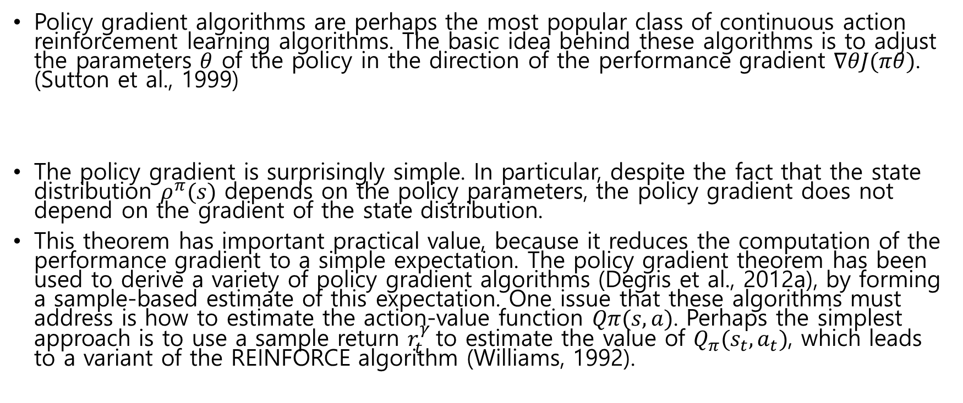
Stochastic Policy Gradient Theorem
Policy gradient algorithms are perhaps the most popular class of continuous action reinforcement learning algorithms. The basic idea behind these algorithms is to adjust the parameters $θ$ of the policy in the direction of the performance gradient $∇θJ(πθ)$. (Sutton et al., 1999)
The policy gradient is surprisingly simple. In particular, despite the fact that the state distribution $ρ^{π}(s)$ depends on the policy parameters, the policy gradient does not depend on the gradient of the state distribution.
This theorem has important practical value, because it reduces the computation of the performance gradient to a simple expectation. The policy gradient theorem has been used to derive a variety of policy gradient algorithms (Degris et al., 2012a), by forming a sample-based estimate of this expectation. One issue that these algorithms must address is how to estimate the action-value function $Qπ(s, a)$. Perhaps the simplest approach is to use a sample return $r_{t}^{γ}$to estimate the value of $Q_{π}(s_{t}, a_{t})$, which leads to a variant of the REINFORCE algorithm (Williams, 1992).

Slide 10
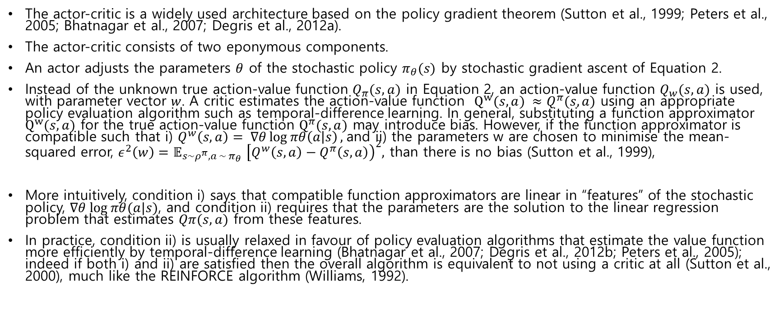
Stochastic Actor-Critic Algorithms
The actor-critic is a widely used architecture based on the policy gradient theorem (Sutton et al., 1999; Peters et al., 2005; Bhatnagar et al., 2007; Degris et al., 2012a).
The actor-critic consists of two eponymous components.
An actor adjusts the parameters $θ$ of the stochastic policy $π_{θ}(s)$ by stochastic gradient ascent of Equation 2.
Instead of the unknown true action-value function $Q_{π}(s, a)$ in Equation 2, an action-value function $Q_{w}(s, a)$ is used, with parameter vector $w$. A critic estimates the action-value function $Q^{w}(s, a) ≈Q^{π}(s, a)$ using an appropriate policy evaluation algorithm such as temporal-difference learning. In general, substituting a function approximator $Q^{w}(s, a)$ for the true action-value function $Q^{π}(s, a)$ may introduce bias. However, if the function approximator is compatible such that i) $Q^{w}\left(s, a\right)= ∇θ\log{πθ\left(a | s\right)},$and ii) the parameters w are chosen to minimise the mean-squared error, $ε^{2}\left(w\right)=𝔼_{s\sim ρ^{π}, a \sim π_{θ} }{\left[Q^{w}\left(s,a\right)−Q^{π}\left(s,a\right)\right)}^{2},$ than there is no bias (Sutton et al., 1999),
More intuitively, condition i) says that compatible function approximators are linear in “features” of the stochastic policy, $∇θ log⁡πθ(a|s)$, and condition ii) requires that the parameters are the solution to the linear regression problem that estimates $Qπ(s, a)$ from these features.
In practice, condition ii) is usually relaxed in favour of policy evaluation algorithms that estimate the value function more efficiently by temporal-difference learning (Bhatnagar et al., 2007; Degris et al., 2012b; Peters et al., 2005); indeed if both i) and ii) are satisfied then the overall algorithm is equivalent to not using a critic at all (Sutton et al., 2000), much like the REINFORCE algorithm (Williams, 1992).

Slide 11

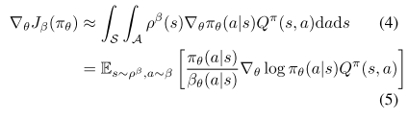
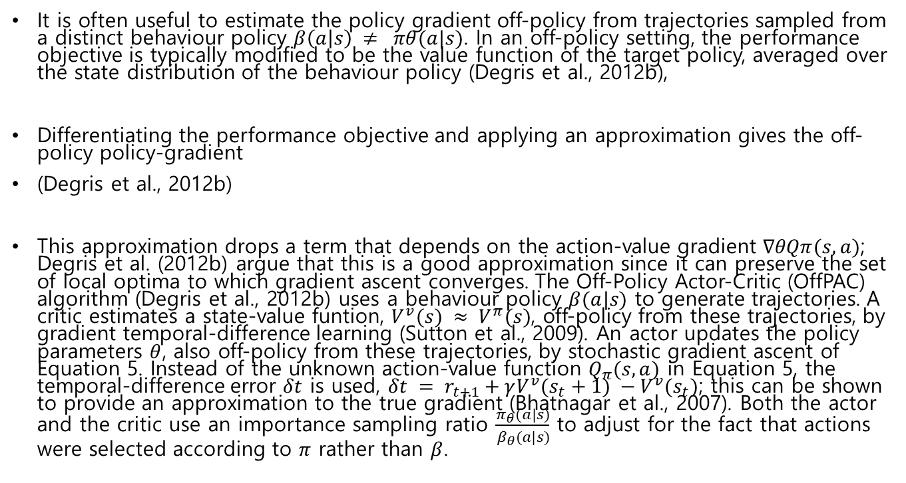
Off-Policy Actor-Critic
It is often useful to estimate the policy gradient off-policy from trajectories sampled from a distinct behaviour policy $β\left(a | s\right) ≠ πθ(a|s)$. In an off-policy setting, the performance objective is typically modified to be the value function of the target policy, averaged over the state distribution of the behaviour policy (Degris et al., 2012b),
Differentiating the performance objective and applying an approximation gives the off-policy policy-gradient
(Degris et al., 2012b)
This approximation drops a term that depends on the action-value gradient $∇θQπ(s, a)$; Degris et al. (2012b) argue that this is a good approximation since it can preserve the set of local optima to which gradient ascent converges. The Off-Policy Actor-Critic (OffPAC) algorithm (Degris et al., 2012b) uses a behaviour policy $β(a|s)$ to generate trajectories. A critic estimates a state-value funtion, $V^{v}(s) ≈ V^{π}(s)$, off-policy from these trajectories, by gradient temporal-difference learning (Sutton et al., 2009). An actor updates the policy parameters $θ$, also off-policy from these trajectories, by stochastic gradient ascent of Equation 5. Instead of the unknown action-value function $Q_{π}(s, a)$ in Equation 5, the temporal-difference error $δt$ is used, $δt = r_{t+1}+γV^{v}(s_{t}+1) −V^{v}(s_{t})$; this can be shown to provide an approximation to the true gradient (Bhatnagar et al., 2007). Both the actor and the critic use an importance sampling ratio $\frac{π_{θ}(a|s)}{β_{θ}(a|s)}$ to adjust for the fact that actions were selected according to $π$ rather than $β$.

Slide 12
Gradients of Deterministic Policies
We provide several ways to derive and understand this result.
First we provide an informal intuition behind the form of the deterministic policy gradient. We then give a formal proof of the deterministic policy gradient theorem from first principles.
Finally, we show that the deterministic policy gradient theorem is in fact a limiting case of the stochastic policy gradient theorem.

Slide 13


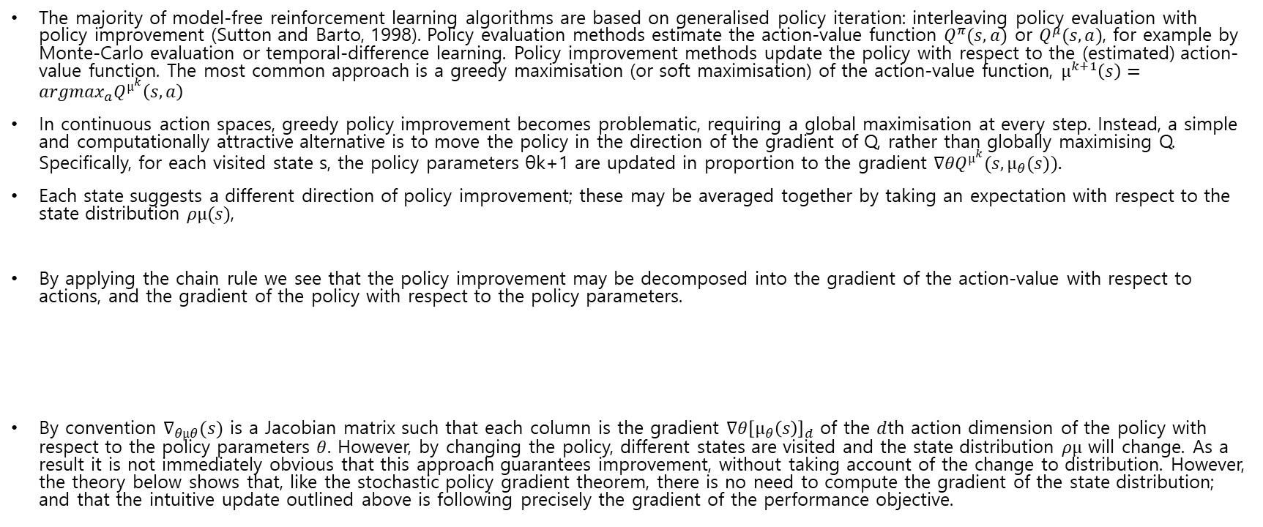
Action-Value Gradients
The majority of model-free reinforcement learning algorithms are based on generalised policy iteration: interleaving policy evaluation with policy improvement (Sutton and Barto, 1998). Policy evaluation methods estimate the action-value function $Q^{π}(s, a)$ or $Q^{μ}(s, a)$, for example by Monte-Carlo evaluation or temporal-difference learning. Policy improvement methods update the policy with respect to the (estimated) action-value function. The most common approach is a greedy maximisation (or soft maximisation) of the action-value function, $µ^{k+1}\left(s\right)=argmax_{a}Q^{µ^{k}}\left(s,a\right)$
In continuous action spaces, greedy policy improvement becomes problematic, requiring a global maximisation at every step. Instead, a simple and computationally attractive alternative is to move the policy in the direction of the gradient of Q, rather than globally maximising Q. Specifically, for each visited state s, the policy parameters θk+1 are updated in proportion to the gradient $∇θQ^{µ^{k}}(s, µ_{θ}(s)).$
Each state suggests a different direction of policy improvement; these may be averaged together by taking an expectation with respect to the state distribution $ρµ(s)$,
By applying the chain rule we see that the policy improvement may be decomposed into the gradient of the action-value with respect to actions, and the gradient of the policy with respect to the policy parameters.
By convention $∇_{θµθ}(s)$ is a Jacobian matrix such that each column is the gradient $∇θ{\left[µ_{θ}\left(s\right)\right]}_{d}$ of the $d$th action dimension of the policy with respect to the policy parameters $θ$. However, by changing the policy, different states are visited and the state distribution $ρµ$ will change. As a result it is not immediately obvious that this approach guarantees improvement, without taking account of the change to distribution. However, the theory below shows that, like the stochastic policy gradient theorem, there is no need to compute the gradient of the state distribution; and that the intuitive update outlined above is following precisely the gradient of the performance objective.

Slide 14

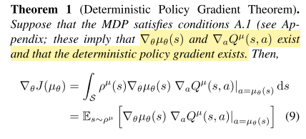

Deterministic Policy Gradient Theorem
We now formally consider a deterministic policy $µ_{θ} : S → A$ with parameter vector $θ ∈ℝ_{n}.$ We define a performance objective $J(µ_{θ}) =𝔼 [r_{1}^{γ}|µ]$, and define probability distribution $p(s → s′, t, µ)$ and discounted state distribution $ρ^{µ}(s)$ analogously to the stochastic case. This again lets us to write the performance objective as an expectation,

Slide 15
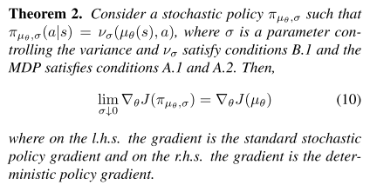

Limit of the Stochastic Policy Gradient
The deterministic policy gradient theorem does not at first glance look like the stochastic version (Equation 2). However, we now show that, for a wide class of stochastic policies, including many bump functions, the deterministic policy gradient is indeed a special (limiting) case of the stochastic policy gradient.
We parametrise stochastic policies $π_{µ_{θ},σ}$ by a deterministic policy $µ_{θ} : S → A$and a variance parameter $σ$, such that for $σ$ = 0 the stochastic policy is equivalent to the deterministic policy, $πµθ,0 ≡ µθ$. Then we show that as $σ → 0$ the stochastic policy gradient converges to the deterministic gradient.
This is an important result because it shows that the familiar machinery of policy gradients, for example compatible function approximation (Sutton et al., 1999), natural gradients (Kakade, 2001), actor-critic (Bhatnagar et al., 2007), or episodic/batch methods (Peters et al., 2005), is also applicable to deterministic policy gradients

Slide 16
Deterministic Actor-Critic Algorithms
We now use the deterministic policy gradient theorem to derive both on-policy and off-policy actor-critic algorithms. We begin with the simplest case – on-policy updates, using a simple Sarsa critic – so as to illustrate the ideas as clearly as possible.
We then consider the off-policy case, this time using a simple Q-learning critic to illustrate the key ideas. These simple algorithms may have convergence issues in practice, due both to bias introduced by the function approximator, and also the instabilities caused by off-policy learning. We then turn to a more principled approach using compatible function approximation and gradient temporal-difference learning.

Slide 17

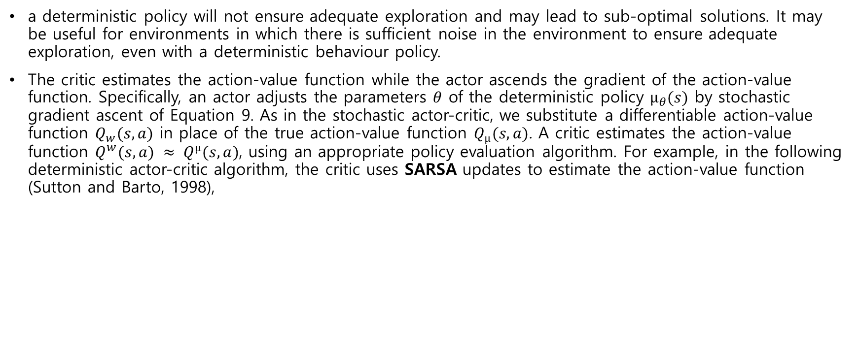
On-Policy Deterministic Actor-Critic
a deterministic policy will not ensure adequate exploration and may lead to sub-optimal solutions. It may be useful for environments in which there is sufficient noise in the environment to ensure adequate exploration, even with a deterministic behaviour policy.
The critic estimates the action-value function while the actor ascends the gradient of the action-value function. Specifically, an actor adjusts the parameters $θ$ of the deterministic policy $µ_{θ}(s)$ by stochastic gradient ascent of Equation 9. As in the stochastic actor-critic, we substitute a differentiable action-value function $Q_{w}(s, a)$ in place of the true action-value function $Q_{µ}(s, a)$. A critic estimates the action-value function $Q^{w}(s, a) ≈ Q^{µ}(s, a)$, using an appropriate policy evaluation algorithm. For example, in the following deterministic actor-critic algorithm, the critic uses SARSA updates to estimate the action-value function (Sutton and Barto, 1998),

Slide 18
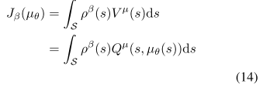
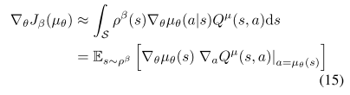

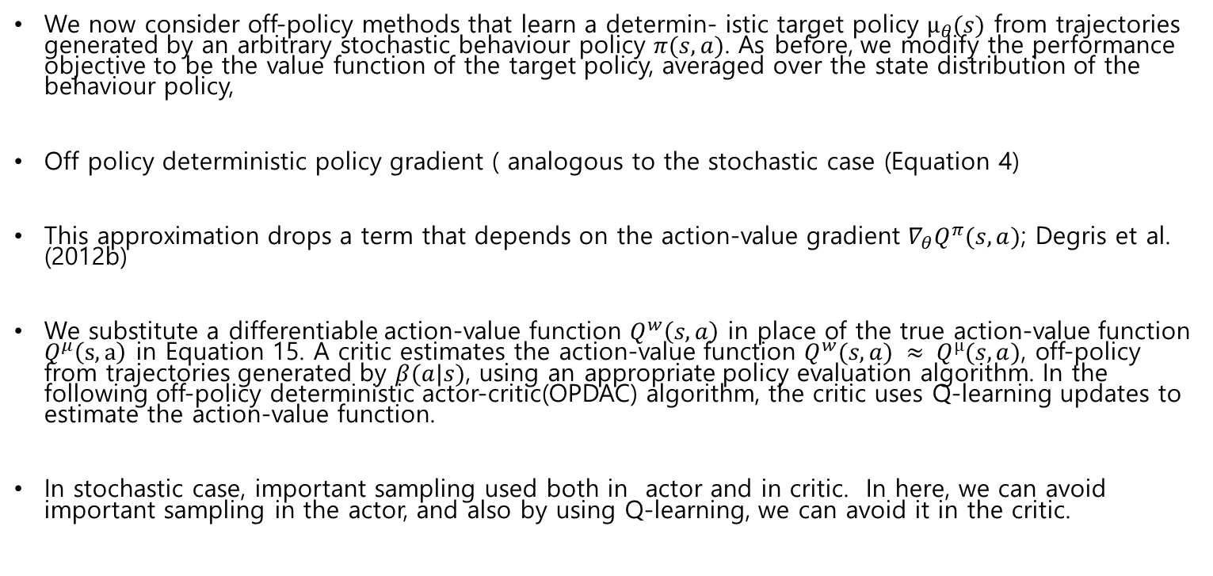
Off-Policy Deterministic Actor-Critic
We now consider off-policy methods that learn a determin- istic target policy $µ_{θ}(s)$ from trajectories generated by an arbitrary stochastic behaviour policy $π(s, a)$. As before, we modify the performance objective to be the value function of the target policy, averaged over the state distribution of the behaviour policy,
Off policy deterministic policy gradient ( analogous to the stochastic case (Equation 4)
This approximation drops a term that depends on the action-value gradient $∇_{θ}Q^{π}(s, a)$; Degris et al. (2012b)
We substitute a differentiable action-value function $Q^{w}\left(s,a\right)$ in place of the true action-value function $Q^{μ}\left(s,a\right)$ in Equation 15. A critic estimates the action-value function $Q^{w}(s, a) ≈ Q^{µ}(s, a)$, off-policy from trajectories generated by $β(a|s)$, using an appropriate policy evaluation algorithm. In the following off-policy deterministic actor-critic(OPDAC) algorithm, the critic uses Q-learning updates to estimate the action-value function.
In stochastic case, important sampling used both in actor and in critic. In here, we can avoid important sampling in the actor, and also by using Q-learning, we can avoid it in the critic.

Slide 19
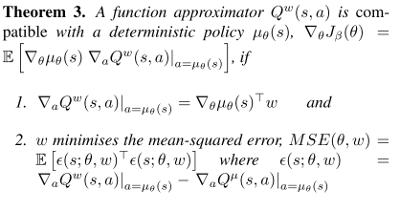
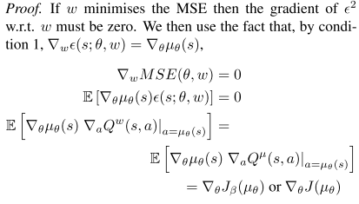
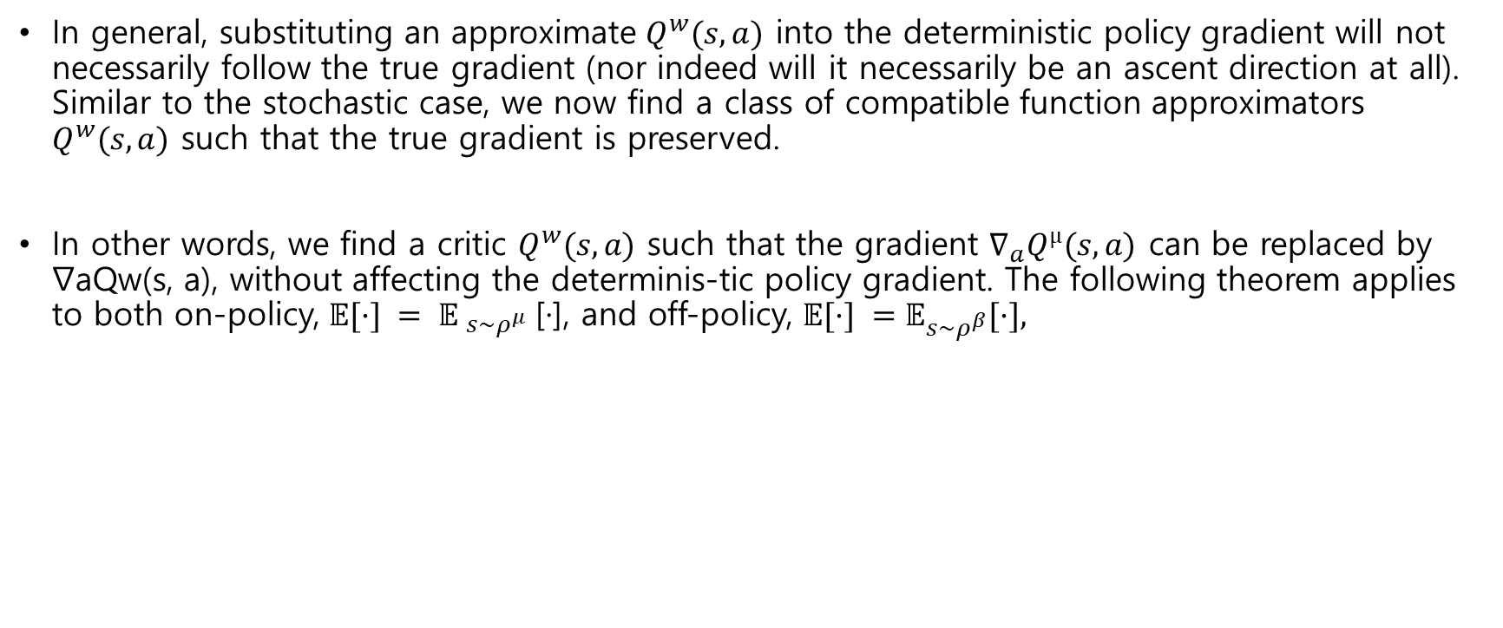
Compatible Function Approximation
In general, substituting an approximate $Q^{w}(s, a)$ into the deterministic policy gradient will not necessarily follow the true gradient (nor indeed will it necessarily be an ascent direction at all). Similar to the stochastic case, we now find a class of compatible function approximators $Q^{w}(s, a)$ such that the true gradient is preserved.
In other words, we find a critic $Q^{w}(s, a)$ such that the gradient $∇_{a}Q^{µ}(s, a)$ can be replaced by ∇aQw(s, a), without affecting the determinis-tic policy gradient. The following theorem applies to both on-policy, $𝔼[·] = {𝔼 }_{s\sim ρ^{μ}}$[·], and off-policy, $𝔼[·] =𝔼_{s\sim ρ^{β}}[·],$

Slide 20
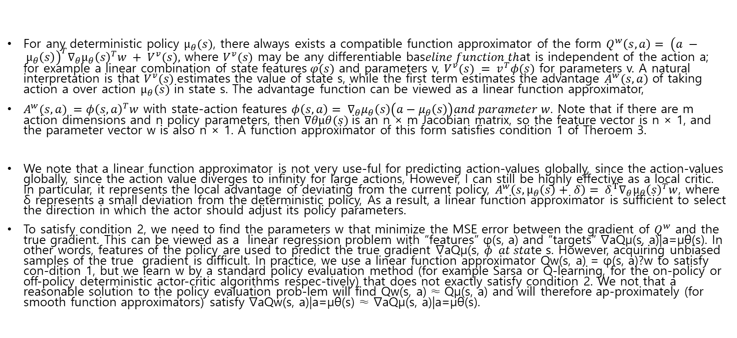
Compatible Function Approximation (Cont)
For any deterministic policy $µ_{θ}(s)$, there always exists a compatible function approximator of the form $Q^{w}\left(s, a\right)= {\left(a − µ_{θ}\left(s\right)\right)}^{T}∇_{θ}µ_{θ}{\left(s\right)}^{T}w + V^{v}(s),$ where $V^{v}(s)$ may be any differentiable bas$eline function th$at is independent of the action a; for example a linear combination of state features$φ(s)$ and parameters v, $V^{v}(s) = v^{T}φ(s)$ for parameters v. A natural interpretation is that $V^{v}(s)$estimates the value of state s, while the first term estimates the advantage $A^{w}(s, a)$ of taking action a over action $µ_{θ}(s)$ in state s. The advantage function can be viewed as a linear function approximator,
$A^{w}(s, a) =φ{\left(s, a\right)}^{T}w$ with state-action features $φ\left(s,a\right)= ∇_{θ}μ_{θ}\left(s\right)\left(a−μ_{θ}\left(s\right)\right)and parameter w$. Note that if there are m action dimensions and n policy parameters, then $∇θµθ(s)$is an n × m Jacobian matrix, so the feature vector is n × 1, and the parameter vector w is also n × 1. A function approximator of this form satisfies condition 1 of Theroem 3.
We note that a linear function approximator is not very use-ful for predicting action-values globally, since the action-values globally, since the action value diverges to infinity for large actions, However, I can still be highly effective as a local critic. In particular, it represents the local advantage of deviating from the current policy, $A^{w}\left(s, µ_{θ}\left(s\right)+ δ\right)= δ^{T}∇_{θ}µ_{θ}{\left(s\right)}^{T}w$, where δ represents a small deviation from the deterministic policy, As a result, a linear function approximator is sufficient to select the direction in which the actor should adjust its policy parameters.
To satisfy condition 2, we need to find the parameters w that minimize the MSE error between the gradient of $Q^{w}$ and the true gradient. This can be viewed as a linear regression problem with “features” φ(s, a) and “targets” ∇aQµ(s, a)|a=µθ(s). In other words, features of the policy are used to predict the true gradient ∇aQµ(s, $φ at sta$te s. However, acquiring unbiased samples of the true gradient is difficult. In practice, we use a linear function approximator Qw(s, a) = φ(s, a)?w to satisfy con-dition 1, but we learn w by a standard policy evaluation method (for example Sarsa or Q-learning, for the on-policy or off-policy deterministic actor-critic algorithms respec-tively) that does not exactly satisfy condition 2. We not that a reasonable solution to the policy evaluation prob-lem will find Qw(s, a) ≈ Qµ(s, a) and will therefore ap-proximately (for smooth function approximators) satisfy ∇aQw(s, a)|a=µθ(s) ≈ ∇aQµ(s, a)|a=µθ(s).

Slide 21
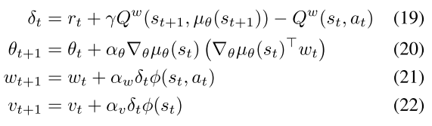
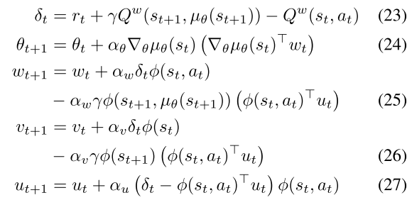
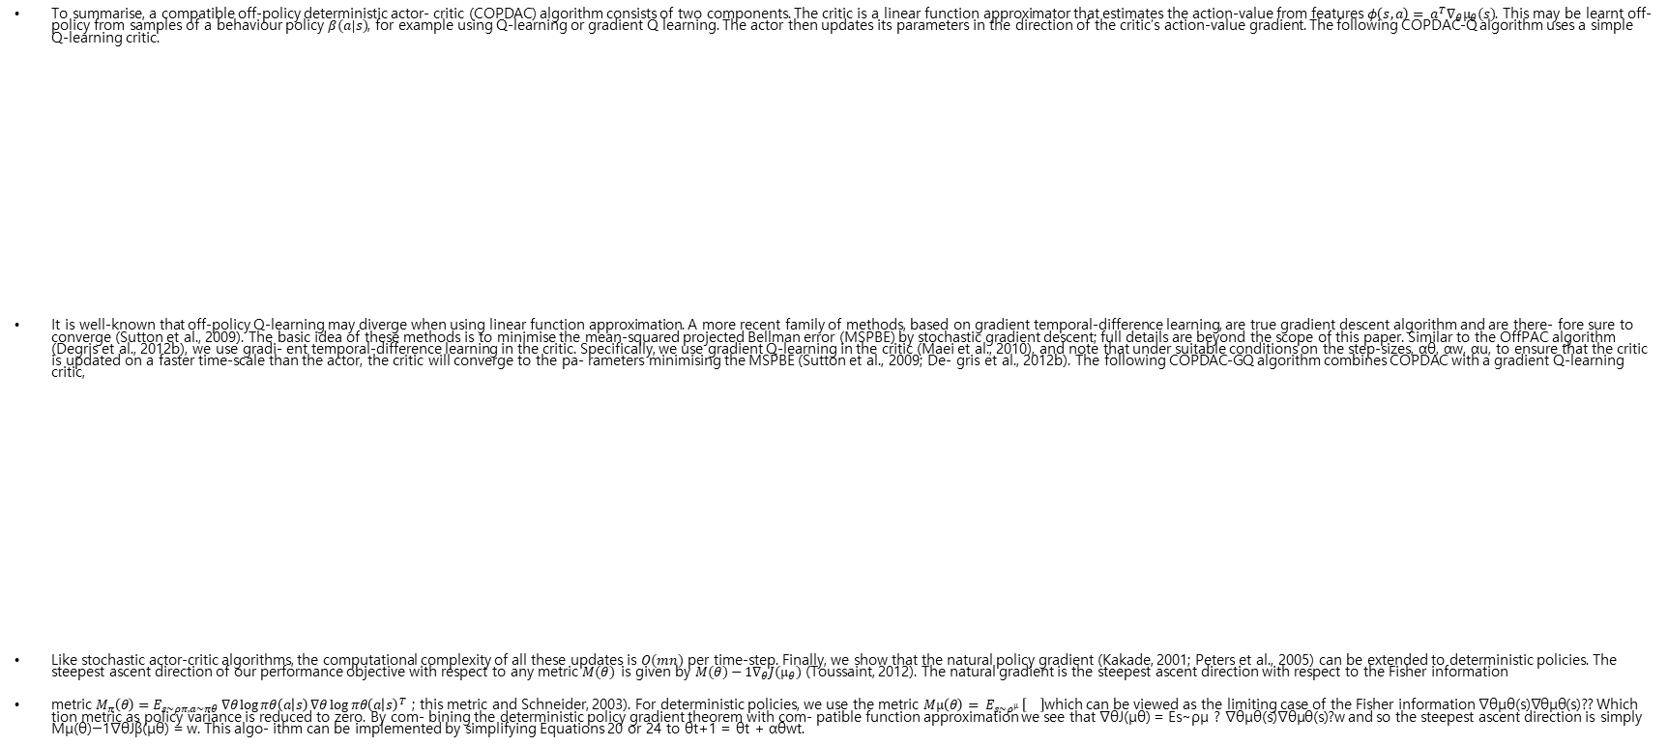
Compatible Function Approximation (Cont)
To summarise, a compatible off-policy deterministic actor- critic (COPDAC) algorithm consists of two components. The critic is a linear function approximator that estimates the action-value from features $φ\left(s, a\right)= a^{T}∇_{θ}µ_{θ}(s)$. This may be learnt off-policy from samples of a behaviour policy $β(a|s)$, for example using Q-learning or gradient Q learning. The actor then updates its parameters in the direction of the critic’s action-value gradient. The following COPDAC-Q algorithm uses a simple Q-learning critic.
It is well-known that off-policy Q-learning may diverge when using linear function approximation. A more recent family of methods, based on gradient temporal-difference learning, are true gradient descent algorithm and are there- fore sure to converge (Sutton et al., 2009). The basic idea of these methods is to minimise the mean-squared projected Bellman error (MSPBE) by stochastic gradient descent; full details are beyond the scope of this paper. Similar to the OffPAC algorithm (Degris et al., 2012b), we use gradi- ent temporal-difference learning in the critic. Specifically, we use gradient Q-learning in the critic (Maei et al., 2010), and note that under suitable conditions on the step-sizes, αθ, αw, αu, to ensure that the critic is updated on a faster time-scale than the actor, the critic will converge to the pa- rameters minimising the MSPBE (Sutton et al., 2009; De- gris et al., 2012b). The following COPDAC-GQ algorithm combines COPDAC with a gradient Q-learning critic,
Like stochastic actor-critic algorithms, the computational complexity of all these updates is $O(mn)$ per time-step. Finally, we show that the natural policy gradient (Kakade, 2001; Peters et al., 2005) can be extended to deterministic policies. The steepest ascent direction of our performance objective with respect to any metric $M(θ)$ is given by $M(θ)−1∇_{θ}J(µ_{θ})$ (Toussaint, 2012). The natural gradient is the steepest ascent direction with respect to the Fisher information
metric $M_{π}\left(θ\right)=E_{s∼ρπ,a∼πθ} ∇θ\log{πθ\left(a | s\right)}∇θ{\log{πθ\left(a | s\right)}}^{T}$ ; this metric and Schneider, 2003). For deterministic policies, we use the metric $Mµ\left(θ\right)= E_{s∼ρ^{µ}} \left[\right]$which can be viewed as the limiting case of the Fisher information ∇θµθ(s)∇θµθ(s)?? Which tion metric as policy variance is reduced to zero. By com- bining the deterministic policy gradient theorem with com- patible function approximation we see that ∇θJ(µθ) = Es∼ρµ ? ∇θµθ(s)∇θµθ(s)?w and so the steepest ascent direction is simply Mµ(θ)−1∇θJβ(µθ) = w. This algo- ithm can be implemented by simplifying Equations 20 or 24 to θt+1 = θt + αθwt.

